Slide 1
Object Oriented Analysis & Design Module-5 (RL 5.3.5)
Harvinder S Jabbal

Slide 2
Drawing Package Diagram for PoS System

Slide 3
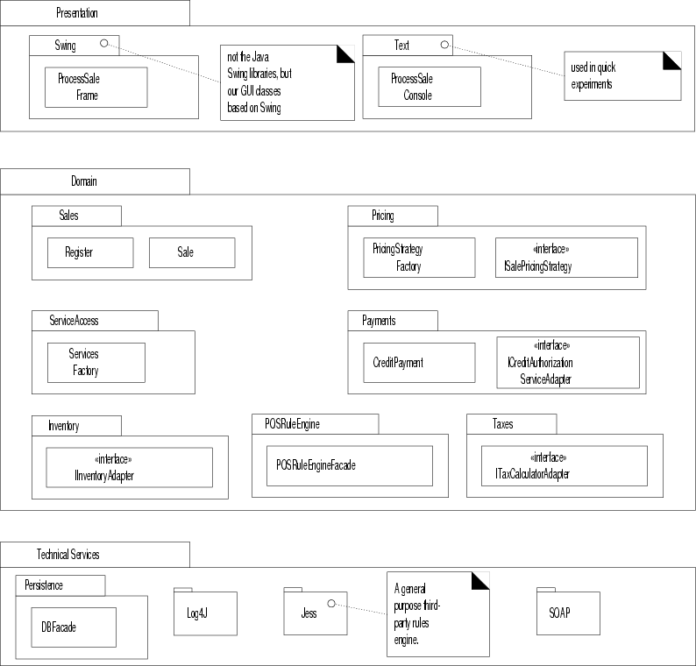
Partial logical view of layers in the NextGen application.

Slide 4
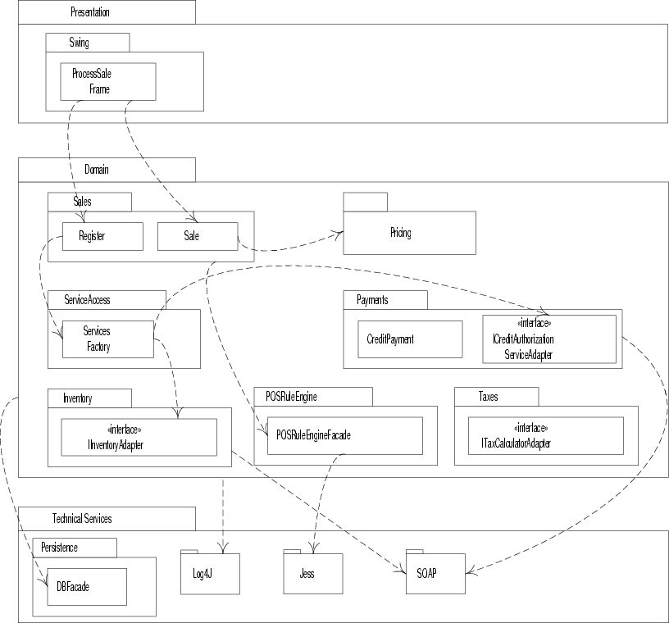
Partial coupling between packages

Slide 5
Acknowledgement
Slides are based on Course Text Books:
Applying UMP and Patterns (An Introduction to Object-Oriented Analysis and Design and Iterative Development) : Craig Larman
UMP Distilled (A Brief Guide to the Standard Object Modeling Langauge) : Martin Fowler
Design Patterns (Elements of Reusable Object-Oriented Software) : Erich Gama | Richard Helm | Rapph Johnson | John Vlissides alias GoF.
Also: http://agilemodeling.com/style/packageDiagram.htm
http://www.uml-diagrams.org/package-diagrams.htm

